Slide 1

M-Cube: A Millimeter-Wave Massive MIMO Software Radio*
http://m3.ucsd.edu/sdr
Renjie Zhao, Timothy Woodford, Teng Wei,
Kun Qian and Xinyu Zhang
Department of Electrical and Computer Engineering
University of California San Diego
Notes:
Hi everyone, my name is Renjie Zhao, a phd student of UC san diego. Today, I’m going to introduce our work: Mcube A Millimeter-Wave Massive MIMO Software Radio.

Slide 2
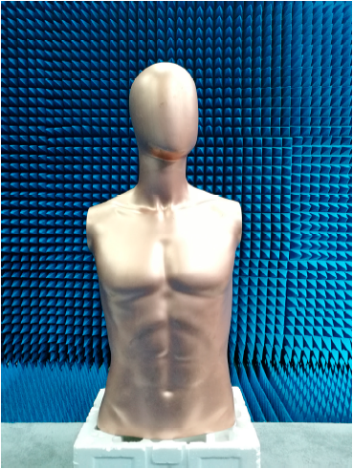
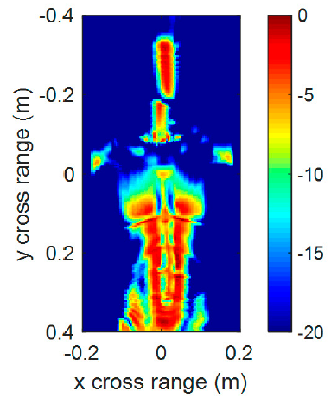

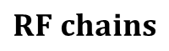
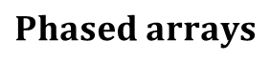
Millimeter-Wave Massive MIMO
$$Phased arrays$$
$$RF chains$$
RF
RF
$$Baseband$$
Input
BB
BB
RF
RF
MIMO array for 802.11ay to support 100+ Gbps throughput
IEEE 802.11-15/0808
Millimeter-wave holographic imaging
Ye et. al, IEEE Sensors 2017
Notes:
Millimeter-wave (mmWave) technologies represent a cornerstone for emerging wireless network infrastructure, and for RF sensing systems in security, health, and automotive domains.
#### Through a MIMO array of phased arrays with hundreds of antenna elements, mmWave can boost wireless bit-rates to more than 100 Gbps as proposed in the mmWave wifi standard 802.11ay, #### and can potentially achieve near-vision sensing resolution.
\\But we still see few work related to MIMO based mmWave in our field.

Slide 3
Required Capabilities for Community
Low-cost and large-scale phased arrays;
Millimeter-wave MIMO architectures;
Fast beam sweeping;
Reconfigurability of:
beam patterns;
communication/sensing algorithms;
network stack.
Notes:
To conduct research on Millimeter-Wave Massive MIMO, we believe a programmable experimental platform with the following critical capabilities is needed.
(i) It should be equipped with low-cost and large phased arrays which represent the key feature of mmWave radios;
(ii) It should support the mmWave MIMO architectures which is to be used in 5G NR and 802.11ay;
(iii) Fast beam sweeping should be available which allows real-time beam sweeping to accommodate high mobility networking/sensing scenarios;
(iv) It should allow reconfiguration of beam patterns, communication/sensing algorithms and network stack.
\\Existing mmWave experimental platforms are either too costly (around $200K per link [33,39]), or lack a reconfigurable phased array antenna with reasonable size.

Slide 4
Lack of widely affordable platform supporting mmWave Massive MIMO
Notes:
Unfortunately, to date, there is no widely affordable platform which satisfies all the capabilities, which is impeding research in this field.

Slide 5
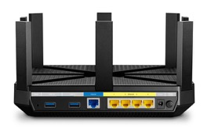
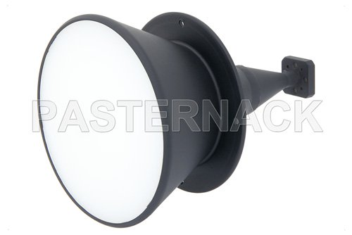
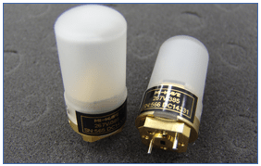
Millimeter-wave Networking Technologies
Commercialized Device RSSI CSI/CIR based
Passive fix direction antenna SDR
TP-Link 802.11ac/ad tri-band access point (AP)
Horn antenna or omni-directional antenna with emulation
RSSI
802.11ay standard not finalized, less device available.
Notes:
One widely utilized and deeply investigated platform is the commercial 802.11ad access point. This commodity radio device is usually cheap because the cost is amortized due to the large manufacturing volume, #### but the available information is usually just RSSI, i.e., the signal strength which really limits the capability of the platform to some coarse grain beam algorithm analyzing or network layer evaluation. Also it will only be widely available after the standard has been finalized. #### This is the reason why there is still less MIMO compatible 802.11ay device being available now, because 802.11ay standard is still under development.
#### There has been software defined radios equipped with mechanically steereable horn antennas or omnidirectional antennas. These platforms can’t do the fast beam direction sweeping because they need mechanical turning and can be hardly used to investigate the severe problems of high mobility scenario.

Slide 6
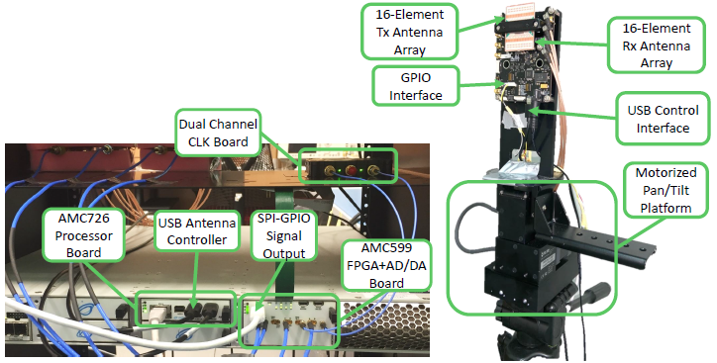
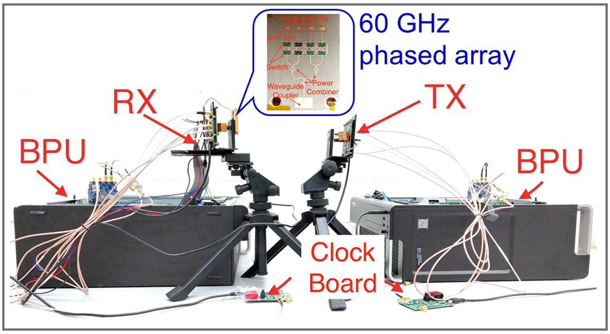
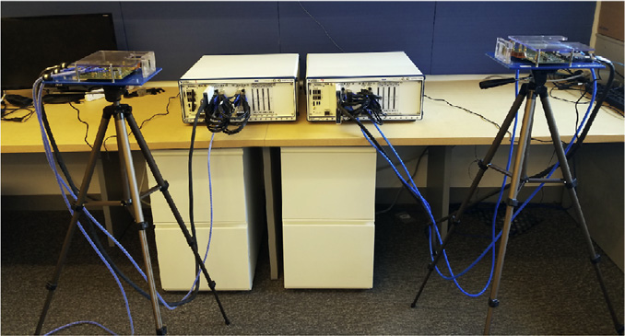
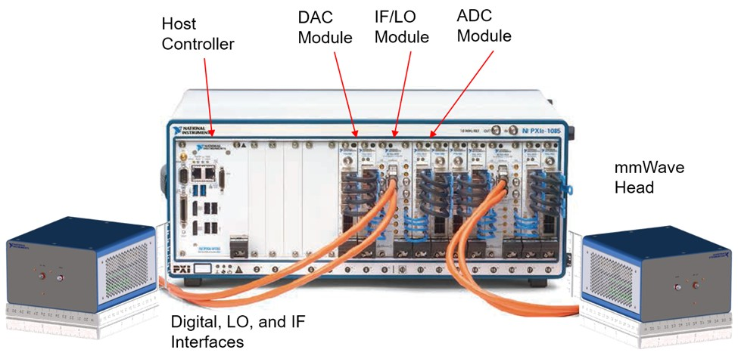
No affordable MIMO SDR
VubIQ based Platform
OpenMili Zhang et.al MobiCom 2016
mm-FLEX Jesus et.al MobiSys 2020
X60 Swetank et.al WiNTECH 2017
NI mmWave Testbed
Notes:
Other researchers have also developed mmWave platforms based on self-built phased array such as the OpenMili project #### or purpose-built front end with discrete components such as mm-FLEX and X60. This kind of design is typically expensive. And none of these existing platforms support mmWave MIMO configuration due to limitations of the RF front-end.
#### The NI mmWave testbed can be used to build up a 2 RF chain MIMO setup with third party phased arrays. But the cost of over $100k per RF chain limits its adoption.
Our M-Cube platform represents the first mmWave MIMO software radio to overcome these limitations and meet the aforementioned critical requirements.

Slide 7
Turning commodity multi-chain 802.11ad radio to SDR
Notes:
Our main idea is to convert a commodity multi-chain 802.11ad radio to an SDR. So that we can take advantage of the low cost of commercialized antenna array while keeping the flexibility of SDR.
//One reason why mmWave SDR usually has one order higher cost is because of the antenna array.

Slide 8
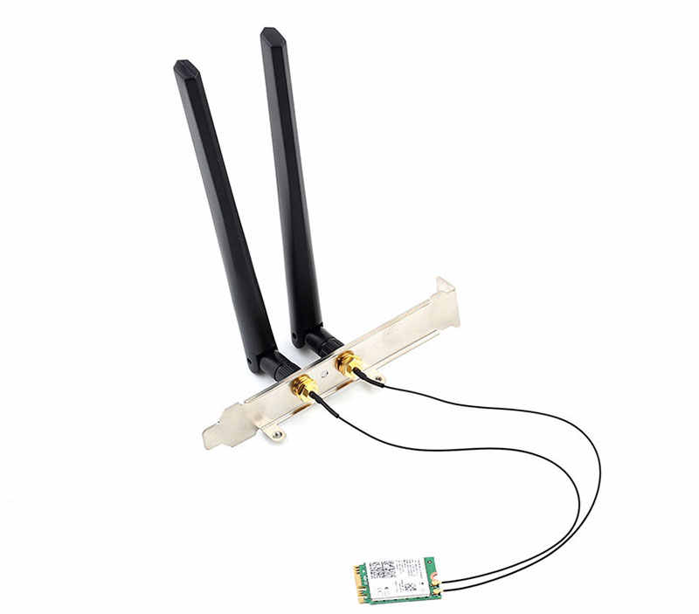
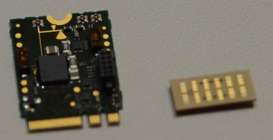
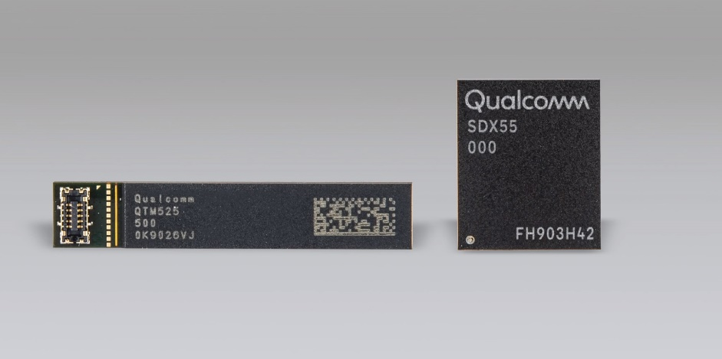
Microwave vs Millimeter-wave
802.11ad
Passive antenna
Large loss for mmWave signal
Active array
NIC
Routing IF
Routing RF
NIC
5G NR
Notes:
mmWave devices do not follow the normal microwave radio architecture which directly routes RF signals from RF chains to the passive antenna. Instead, as in the 802.11ad and 5G NR chipsets shown here, the commercial mmwave devices will have an active phased array #### and the cable between the two parts is routing IF signals which suffer less from cable loss.

Slide 9
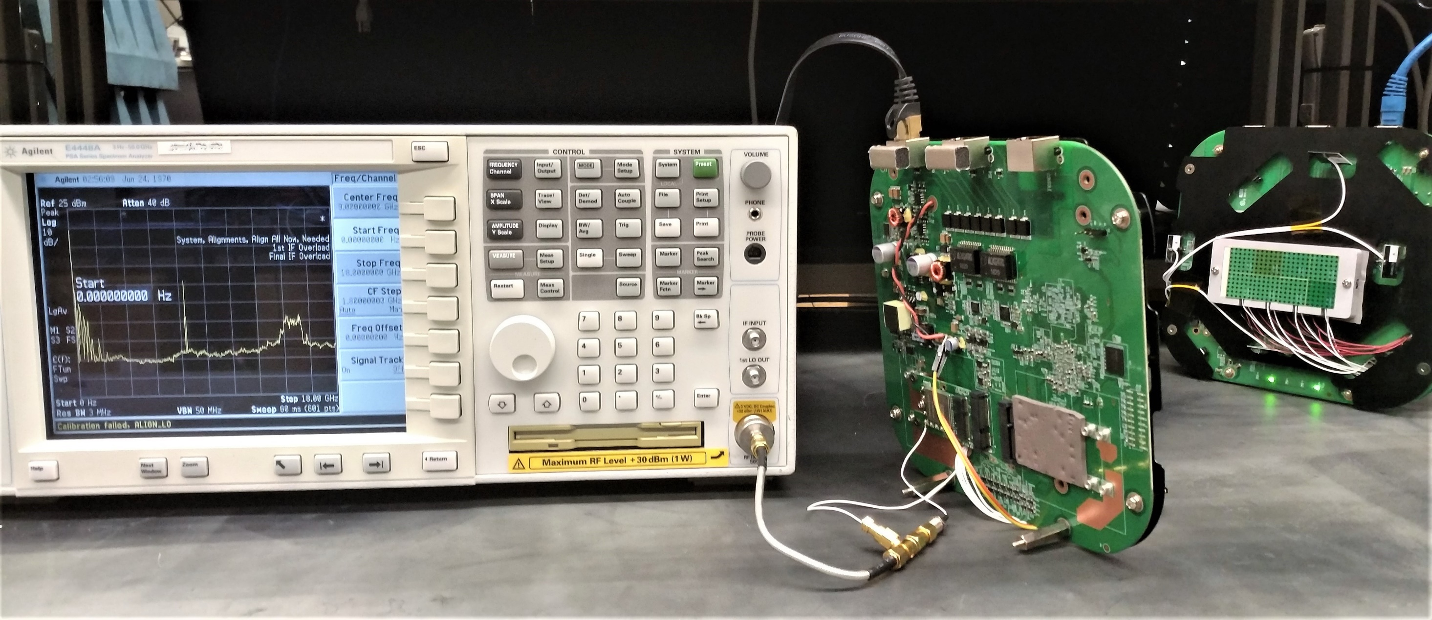
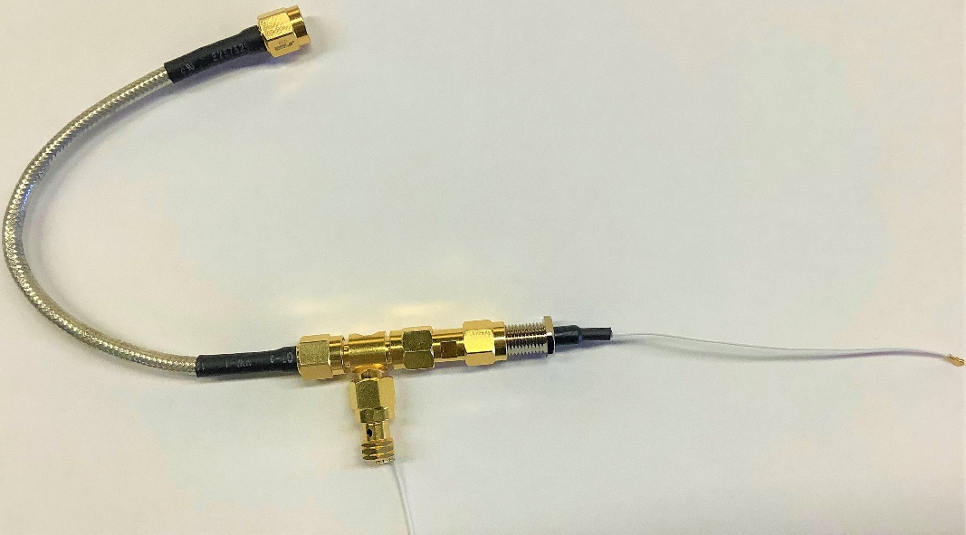
Measurement setup
To spectrum analyzer
Iperf client
Iperf server
From baseband module
Baseband module
To phased array module
Phased array
module
Notes:
To convert the commodity radio into an SDR, we need to first reverse engineer the architecture of the commodity mmWave devices. This figure shows our reverse engineering setup, which aims to measure the signal #### between the Baseband module and the phased array module. #### Let’s zoom into the detail of the spectrum,

Slide 10
Spectrum Content of the Coaxial Cable
Notes:
we found that there are mainly 4 signal components going through the cable. #### The DC voltage is the power supply of the phased array. #### The control signal is used to change the state of the phased array such as changing gain or beam pattern. #### The 7.5GHz reference clock acts as the clock source for the phase array. #### And the 15GHz IF waveform which is going to be converted to the mmwave band.

Slide 11
Commercial Split-IF Architecture
Ref: A 16TX/16RX 60 GHz 802.11ad Chipset With Single Coaxial Interface and Polarization Diversity
Notes:
Based on the measurement findings, the architecture of two modules can be reconstructed like this. Briefly speaking, both the data signal and phased array control commands are generated by the baseband module. If we can hijack the coaxial cable and replace the baseband module with a customized data and control signal generator, then we can convert the entire radio into a software defined radio.

Slide 12
Overview
Notes:
We thus build M-Cube following this design principle. M-Cube consists of the commercial baseband module and phased array module, IF bridge board, baseband processing unit, control FPGA and the host PC.

Slide 13
Overview
Flexible data path
Interface with baseband processing unit (e.g., FPGA)
Real time control path
Sub-µs latency: can do fast beam sweeping
Reconfigurable beam pattern
Massive MIMO mmWave radio/radar
Restructuring commodity 802.11ad radio, low cost and real world case
Notes:
First we will talk about the flexible data path design. The key component here is a bridge board, serving as the bridge between baseband data processor and the phased array module.

Slide 14
Bridge board
DC, Control signal, reference clock
Path 1
Baseband
Phased array
module
module
Off Board
On Board
-
2dB
HPF
Path 2
BPF
20dB
20dB
X2
Mixer
Arbitrary waveform
Notes:
3 signal paths go through the bridge board. There is a direct connection path 1 between baseband module and phase array module #### which is going to reuse the DC, control signal and reference clock. #### The second path is to use the reference clock as the Local Oscillator and convert the baseband waveform to the 15GHz IF signal.

Slide 15
Interfacing with two types of baseband processing units (BPUs)
FMCDAC2
FMC150
RFSoC
WARP
USRP B210
USRP N310
Notes:
The bridge board can work with two typical types of baseband processing units. #### First, it can be interfaced with a wideband ADC/DAC and FPGA. The two baseband ports will be connected to the I and Q paths. Then, the IF bridge board will act as a direct IQ convertor.
#### Second, it can be connected with other SDRs such as WARP, USRP which have been widely used by other researchers.

Slide 16
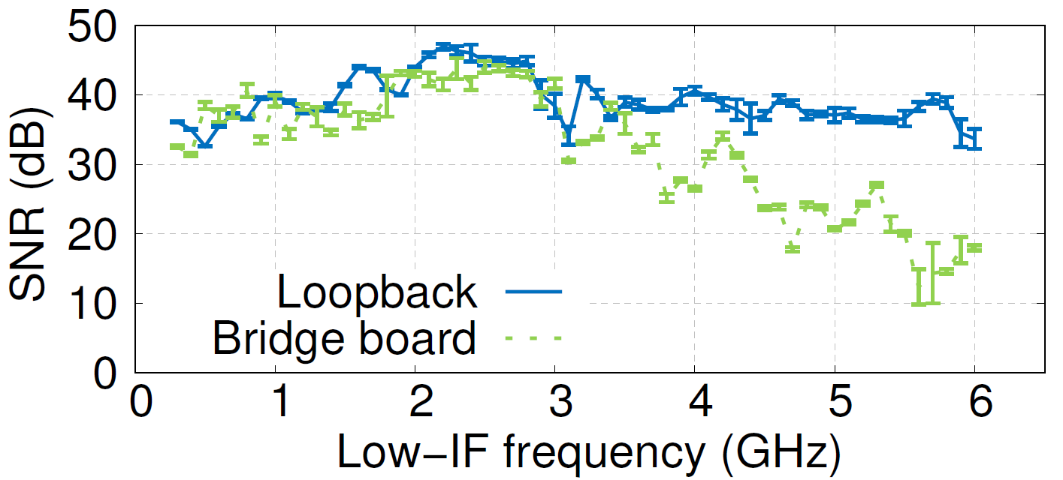
Evaluation – Bridge board
Linear SNR over frequency in working frequency band
USRP N310
Notes:
One concern about the bridge board is whether it degrades the signal quality. #### We conduct an experiment to answer this question. We compare two kinds of connections. The first one is direct connecting the TX and RX of the BPU which acts as the ground truth. The second one is adding the TX and RX bridge board. #### The BPU we used here is the USRP N310, #### we vary the carrier frequency of the N310 and measured the SNR. #### The result shows that for any baseband signals below 3.5GHz, the bridge board barely introduce any SNR loss. This means the bridge board can accommodate up to 3.5GHz of baseband bandwidth without noticeable SNR loss.

Slide 17
Evaluation – Different BPU
Influence of different sampling frequency
 |  | Heterodyne |  |  | Homodyne
BPU device |  | N310 | B210 | WARP | FMC150 | FMCDAQ2
Bandwidth (MHz) |  | 62.5 | 30.72 | 20 | 20 | 500
Loopback SNR (dB) |  | 42.2 | 34.7 | 29.3 | 34.4 | 33.4
OTA SNR (dB) | 64 FFT | 18.3 | 17.2 | 10.1 | NaN | 19.0
 | 16 FFT | 12.5 | 10.5 | 13.8 | 9.2 | 16.6
Notes:
Then we measure both over-the-air (OTA) and loopback SNR with different types of BPUs. #### The different BPUs have different sampling bandwidth.
We found that for most of the BPUs, #### the OTA SNR performance is fairly good as long as the sampling bandwidth is large enough. The main SNR loss is introduced by the RF front end of the commodity mmWave radio, so the OTA SNR is similar among different BPUs.
//We transmitted OFDM signal which separates the channel to several subcarriers. In the OTA transmission, we used 64FFT and 16FFT which means 64 or 16 subcarriers per-channel. The 16FFT is corresponding to 4× wider subcarrier spacing. We have two findings.
The OFDM FFT size has a significant performance impact. Typically, 64 FFT should lead to higher baseband SNR owing to finer grained channel estimation and equalization. However, it also translates into narrower subcarrier spacing, and thus lower RF SNR due to phase noise [34]. This tradeoff manifests itself differently for different BPU devices (e.g., for the WARP and FMC150, 16 FFT leads to higher SNR instead).
The performance of BPU itself does not determine the end-to-end performance, since the RF noise affects more than that of the BPU. For example, the B210 has comparable OTA SNR with N310, despite a lower loopback SNR. On the other hand, the FMCDAQ2 has the best OTA SNR even though the loopback SNR is relatively low.

Slide 18
Overview
Flexible data path
Interface with SDR or GHz baseband converter
Real time control path
Sub-µs latency: can do fast beam sweeping
Reconfigurable beam pattern
Massive MIMO mmWave radio/radar
Restructuring commodity 802.11ad radio, low cost and real world case
Notes:
The control path of M-Cube is generating commands to control the beam patterns of the phased array with low latency.

Slide 19
Control Path Architecture
Phased array module controlled by Baseband module
Reused for PM initialization and codebook loading;
BM controlled by system level driver;
40ms system level delay too large for beam sweeping.
External beam control by Control FPGA
Real time beam sweeping;
Synchronized MIMO multi-array different state control;
Radar mode control.
Control
Path 3
FPGA
Path 1
Baseband
Phased array
module
module
Notes:
The control commands can be sent from the existing baseband module on the commodity mmWave radio. But this will introduce around 40 ms system level delay which is too long for beam sweeping. As an example, scanning 32 beams will take around 1s. But what we want is sub-us level latency.
#### Therefore, we choose to use an external control FPGA to send the real-time beam control commands, which passes through the path3 on the bridge board.
This design also enables two new capabilities. One is to configure the multiple phased arrays on the mmWave MIMO radio to different states (different beam) at the same time. The other is to configure the phased arrays to the radar mode which means one array set to TX and the other RX.
//We designed a server which control the baseband module by using system level driver so that it can send the commands to the phased array module as we want.

Slide 20

Control Path Latency
Control signal
N310 trigger
Phased-array received signal
Sine tone from Tx
RX starts
~775ns
180ns
N310 trigger
485ns
Control signal
Disabled state
Enabled state
170ns
Phased-array received signal
Notes:
The final control path connection is like this, first, #### the BPU, for example the USRP N310 here, provides a trigger to the control FPGA which indicates the BPU begins sampling baseband signals. ####Then the control FPGA will send out the control command to configure the beam pattern. As shown in the figure, the total delay will be less than 1us which is comparable to the beam control latency on a commercial non-programmable mmWave radio.

Slide 21
Overview
Flexible data path
Interface with SDR or GHz baseband converter
Real time control path
Sub-µs latency: can do fast beam sweeping
Reconfigurable beam pattern
Massive MIMO mmWave radio/radar
Restructuring commodity 802.11ad radio, low cost and real world case
Notes:
Then we investigate the phased array module to make the beam pattern reconfigurable.

Slide 22
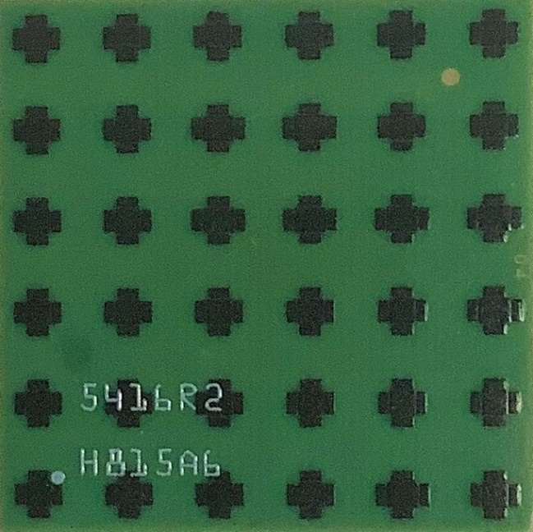
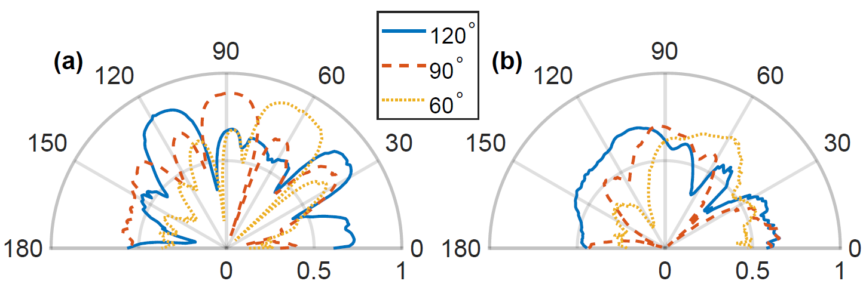
Phased Array Reconfiguration
 | 24 | 22 | 6 | 8
19 | 17 | 23 | 7 | 1 | 3
20 | 18 | 21 | 5 | 2 | 4
28 | 27 | 26 | 9 | 11 | 12
25 | 29 | 32 | 16 | 13 | 10
 | 31 | 30 | 14 | 15
Y
X
Z
Notes:
The phased array in the commodity mmWave radio is a uniform planar array. #### We conducted extensive calibration to find out the mapping of the antenna element and the codebook entrée. Then, we can program the codebook corresponding to the beam pattern we want.
#### This figure shows some examples, where we generate a narrow beam pointing to different angle by using all the antenna elements. Or we can generate a wider beam pointing to different angle by using some of the antenna elements.

Slide 23
Overview
Flexible data path
Interface with SDR or GHz baseband converter
Real time control path
Sub-µs latency: can do fast beam sweeping
Reconfigurable beam pattern
Massive MIMO mmWave radio/radar
Restructuring commodity 802.11ad radio, low cost and real world case
Notes:
Finally, we can easily extend the above architecture into a massive MIMO mmWave radio or radar.

Slide 24
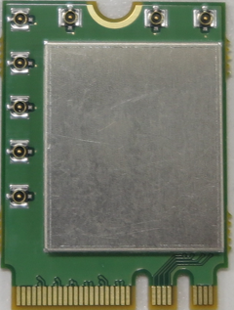
MIMO Architecture
7
2
3
0
8 ports
LO phase coherent
Same data path
4
5
6
1
Notes:
There already exist commercial 802.11ad mmWave radios with multiple phased arrays but a single RF chain. For example, the 802.11ad radio we use in M-Cube has eight IF ports connecting to 8 phaed arrays. ####These ports share the same carrier clock and data path.

Slide 25
MIMO Architecture
Notes:
In M-Cube we repurpose such multi-array radio into a multi RF chain MIMO architecture, as shown here. Different phased array modules are connected to different IF bridge board and sharing the same control FPGA. But they can use separate data channels on the BPU to realize MIMO functionalities.

Slide 26
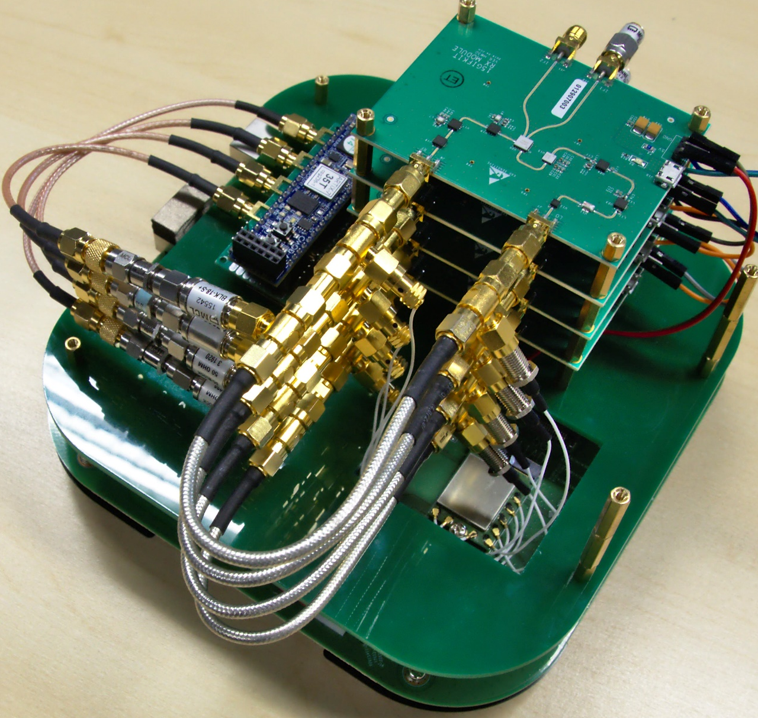
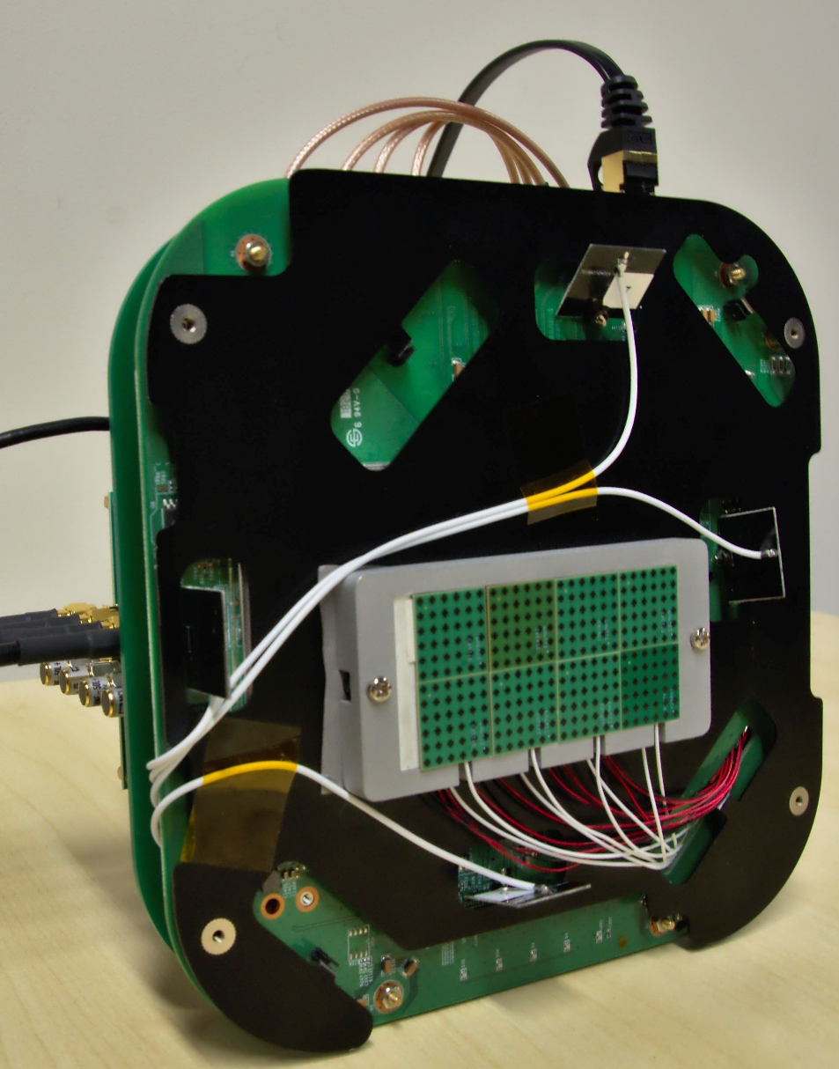
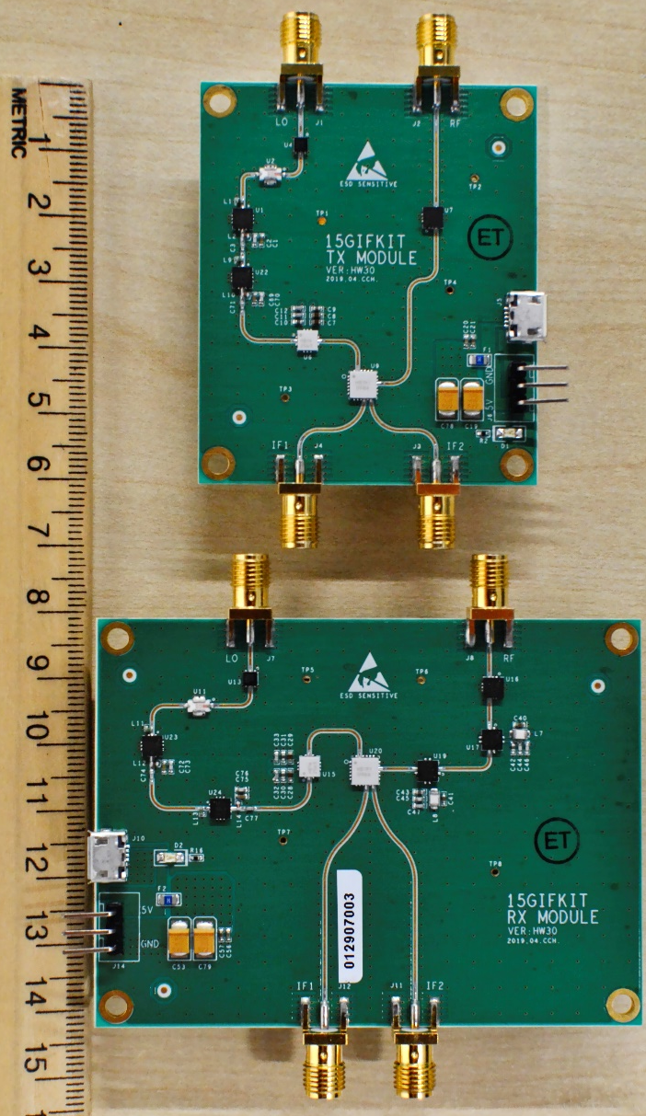
MIMO Setup
(a)
(b)
4 Stacked RX Modules
(c)
PoE Cable
UART to host PC
TX module
Control FPGA
Phased Arrays
SMA Cables to BPU
RX module
Wireless Card
Notes:
Putting everything together, this figure illustrates an M-Cube node, with TX and RX bridge boards and the 4RX MIMO setup.

Slide 27
Case Studies
Unique Opportunities
Array of Phased Arrays Architecture
True MU/SU-MIMO channel estimation
MIMO Radar
Real-time control for fast data collection
MIMO with mobility
Real-world testing of hybrid beamforming algorithms
Notes:
This MIMO architecture provides unique research opportunities for 5G mmWave networking and sensing. #### First our array of phased arrays architecture let the platform can be used for MU/SU-MIMO channel estimation and MIMO radar. #### Then the real-time control for fast beam sweeping and data collection give the opportunity to conduct MIMO experiments under high mobility. #### Here we conduct a few case studies involving the mmWave MIMO hybrid beamforming capabilities.

Slide 28
Hybrid Beamforming
Digital beamforming
Analog beamforming
RF TRX
RF TRX
2-stream Encoder
SVD De-Multiplexing
SVD Multiplexing
2-stream Decoder
RF TRX
RF TRX
Exhaustive
k-best
Evolutionary
Notes:
MmWave MIMO hybrid beamforming generally operates in two stages to realize hybrid beamforming.
(i) #### Select the best beam indices for each phased array (which is doing analog beamforming);
#### The IEEE 802.11ay task group has proposed three possible algorithms for the first stage, exhaustive, k-best and evolutionary. We adopt these algorithms for the our case study.
(ii) #### Measure the channel with the selected beams to achieve either diversity or multiplexing gain (digital beamforming) which is similar to legacy MIMO in 802.11ac.
\\(i) Exhaustive beamforming measures the available throughput for all available combinations of phased array configurations;
(ii) k-best algorithm ranks the configurations based on a coarse sector-level beam sweep and tries the top k configurations.
(iii) Evolutionary algorithm randomly selects configurations to try using a probability derived from the sector sweep, and stops early when the link metric exceeds a certain threshold.

Slide 29
SU-MIMO
Beamforming vs multiplexing gains in different environments
6
0
0
Diversity
5
0
0
Multiplex
4
0
0
3
0
0
Throughput (Mbps
2
0
0
1
0
0
0
Indoor
LoS
Indoor
NLoS
Outdoor
LoS
Outdoor
LoS
Select the digital beamforming mode based on the channel context
Notes:
As one case study, we evaluated 2×2 mmWave MIMO performance in a multipath rich conference room and a multipath-poor outdoor environment. A metal box is placed in between to create NLOS blocking effect.
We used N310 as BPU and collected channel state of all possible combinations of beam selections in a reasonable amount of time. And use the data do the following algorithm evaluation.
compares the capacity for diversity vs. multiplexing in these scenarios, using the same beam training method (k-best).
We observe that the multiplexing capacity is ∼ 50% higher than diversity capacity in the indoor environment, but ∼ 30% lower in outdoor LoS scenarios. However, in outdoor NLoS scenarios, multiplexing achieves higher throughput. Overall, multiplexing gain is most prominent in multipath-rich and NLoS environment.
This result shows that it would be beneficial to adaptively select the digital beamforming mode based on the channel context.
//(b) shows the average throughput among all scenarios after accounting for beam training overhead. We emulate the variation in re-training time due to different mobility levels by varying the temporal separation between measurements, since these algorithms perform complete re-training whenever the channel changes.
The evolutionary algorithm performs better in lower mobility. The algorithms have similar performance under high mobility, but kbest may be preferred since the evolutionary algorithm is stochastic and less predictable.

Slide 30
Recap: Experimental capabilities with M-Cube
Low-cost and large-scale phased arrays;
MmWave MIMO for communication or sensing;
Fast beam sweeping;
Reconfigurability of:
beam patterns;
communication/sensing algorithms;
network stack.
Notes:
As a recap, M-Cube can reproduce the most unique aspects of mmWave radios in a programmable manner. It enables experimental research in mmWave communication and sensing with unprecedented flexibility.

Slide 31
Platform Comparison
 | OpenMilli 2016 | X60 2017 | Mm-FLEX 2020 | M-Cube 2020
Bandwidth | 1GHz | 2GHz | 2GHz | 4GHz (with RFSoC)
Phased Array | 1 | 1 | 1 | 8 (RF chains)
Array Element | 4 | 12 | 16 | 32 (256 in total)
SDR | No | No | No | USRP/WARP etc.
Fast Beam | No | No | Yes | Yes
Cost | $15k(1 by 1) | $150k(1 by 1) | $40k(1 by 1) | $14k (4x4 wide) $3.8k (2x2 narrow)
Notes:
Compared with state-of-the-art mmWave platforms, M-Cube supports larger bandwidth, contains multiple phased arrays for MIMO and a larger phased array. It can be connected with microwave SDRs and can do fast beam sweeping. It also has many times lower cost.

Slide 32
Conclusion
The first mmWave massive MIMO software radio
Suitable for mmWave communication or sensing evaluation
Open sourced and available to the broad research community
Open source hardware and software: http://m3.ucsd.edu/sdr
We are distributing M-Cube replicas to the research community. Contact us if you are interested!
Notes:
To summarize, M-Cube represents the first mmWave massive MIMO software radio. It has been open sourced and can be easily reproduced. We are also distributing M-Cube replicas to other research groups. Please refer to the project website for more information.

Slide 33
Thanks!
http://renjiezhao.github.io

Slide 34
SDR Architecture and Requirements
Phased array
MIMO compatible
Wideband
Following mole’s law
GHz ADC/DAC cost reducing
FPGA integrated RFSoC available
Notes:
Separated by a digital baseband sampling module. The baseband sampling rate needs to be several GHz to cover the typical multiple ghz bandwidth,

Slide 35
Overview
Notes:
Therefore, we build a system like this. We will have a IF bridge board which helps us to generate the arbitrary IF waveform.

Slide 36
Evaluation – Different BPU
Influence of different sampling frequency
 |  | Heterodyne |  |  | Homodyne
BPU device |  | N310 | B210 | WARP | FMC150 | FMCDAQ2
Bandwidth (MHz) |  | 62.5 | 30.72 | 20 | 20 | 500
Loopback SNR (dB) |  | 42.2 | 34.7 | 29.3 | 34.4 | 33.4
OTA SNR (dB) | 64 FFT | 18.3 | 17.2 | 10.1 | NaN | 19.0
 | 16 FFT | 12.5 | 10.5 | 13.8 | 9.2 | 16.6
4× wider subcarrier spacing
Notes:
Then we measure both over-the-air (OTA) and loopback SNR with different BPU. One main difference of different BPU is the sampling rate. We transmitted OFDM signal which separates the channel to several subcarriers. In the OTA transmission, we used 64FFT and 16FFT which means 64 or 16 subcarriers per-channel. The 16FFT is corresponding to 4× wider subcarrier spacing. We have two findings.
The OFDM FFT size has a significant performance impact. Typically, 64 FFT should lead to higher baseband SNR owing to finer grained channel estimation and equalization. However, it also translates into narrower subcarrier spacing, and thus lower RF SNR due to phase noise [34]. This tradeoff manifests itself differently for different BPU devices (e.g., for the WARP and FMC150, 16 FFT leads to higher SNR instead).
The performance of BPU itself does not determine the end-to-end performance, since the RF noise affects more than that of the BPU. For example, the B210 has comparable OTA SNR with N310, despite a lower loopback SNR. On the other hand, the FMCDAQ2 has the best OTA SNR even though the loopback SNR is relatively low.

Slide 37
Control Command Signal
Capture and analyze the command
Reproduce by control FPGA
preamble
command
TX/RX
sector
gain
CRC16
00000000
1
1
1
0
0
0
1
0
1
1
1
0
1
0
0
1
01
0
1
0
0
0
0
0000000
1111
0001011111011110
Notes:
So first we do the reverse engineering to capture and analyze the control command to the phased array module. As shown here, we find out the bits and command mapping so that we can change the state of the phase array as we want. Then, we reproduce the signal by using control FPGA.

Slide 38
Real-time Channel Estimation
OFDM channel estimation
Rapid per-beam measurements
Notes:
Our platform can integrate control and data path for real-time beam scanning. As shown in the figure, the small stages in the RSSI plot corresponding to one beam. During the whole transmission, the beam is keep sweeping. Then, the system can do a OFDM channel estimation on each beam which provide fine-grained per-beam channel measurement capability.

Slide 39
Evaluation – Phase Noise
Reasonable phase noise degrade for bridge board
Expectable performance degradation caused by phase noise
 | Phase noise (dBc/Hz)
 | @1kHz | @10kHz | @100kHz | @1MHz | @10MHz
Ref clk | -51 | -53 | -75 | -101 | -119
LO | -44 | -51 | -72 | -98 | -116
Low-IF+IF | -43 | -51 | -72 | -97 | -115
End-to-end | -30 | -32 | -45 | -73 | -87
Notes:
Comparable phase noise to HMC6300 >100kHz. Flicker noise is a little large. End to end contains noise figure 6dB.

Slide 40
SU-MIMO
All possible beam configurations in a reasonable amount of time
Beamforming vs multiplexing gains in different environments
Compare heuristics for optimizing beam configuration
Notes:
As one case study, we evaluated 2×2 mmWave MIMO performance in a multipath rich conference room and a multipath-poor outdoor environment. Also having a metal box in between to create NLOS blocking effect.
We used N310 as BPU and collected channel state of all possible combinations of beam selections in a reasonable amount of time. And use the data do the following algorithm evaluation.
compares the capacity for diversity vs. multiplexing in these scenarios, using the same beam training method (k-best).
We observe that the multiplexing capacity is ∼ 50% higher than diversity capacity in the indoor environment, but ∼ 30% lower in outdoor LoS scenarios. However, in outdoor NLoS scenarios, multiplexing achieves higher throughput. Overall, multiplexing gain is most prominent in multipath-rich and NLoS environment.
This result shows that it would be beneficial to adaptively select the digital beamforming mode based on the channel context.
(b) shows the average throughput among all scenarios after accounting for beam training overhead. We emulate the variation in re-training time due to different mobility levels by varying the temporal separation between measurements, since these algorithms perform complete re-training whenever the channel changes.
The evolutionary algorithm performs better in lower mobility. The algorithms have similar performance under high mobility, but kbest may be preferred since the evolutionary algorithm is stochastic and less predictable.

Slide 41
MU-MIMO
Previous work used either multiple separate access points or simulations. We can evaluate the effect of digital precoding.
The optimal analog beams with digital precoding applied are near-optimal for the digital precoding case.
Notes:
For MU-MIMO testing, we collected channel data using two codebooks, corresponding to narrow and wide beams.
we determined the total capacity of the channel for three beamforming strategies:
(i) analog beamforming alone, using the best capacity among all beam selections,
(ii) mmWave MIMO using zero-forcing with the globally optimal beam selections,
(iii) mmWave MIMO as in (ii), but using the beams selected in (i).
unlike in the SU-MIMO experiments, MU-MIMO achieves higher capacity in the outdoor environment because multipath introduces additional interference for widely-spaced Rx. Zero-forcing increases the achievable indoor capacity by 2.2× and outdoor capacity by 2.3×, which suggests that there are large performance gains available from hybrid beamforming in MU-MIMO scenarios, rather than analog beamforming alone.

Slide 42
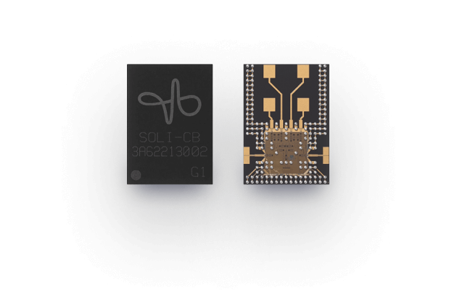
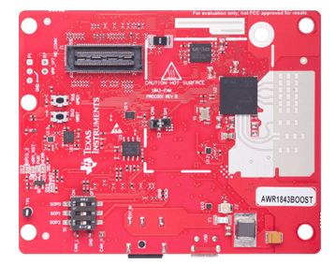
Millimeter-wave Sensing
Small array short range
Fixed function
Large array long range
Flexible design
Google soli
Ti mmWave Radar
?
Notes:
Recent demands on automotive sensing and wireless health have revived the design of consumer-grade mobile mmWave radar. The chipset from google soli has been integrated in google pixel 4 smartphone for gesture recognition.
TI’s mmwave radar is released targeting the automotive sensing scenario.
But this systems only have small array with a short working range. They are also using predefined FMCW waveform which limited the flexibility. Therefore, a platform with large array, long range and arbitrary waveform platform is still absent.
////The 5G NR standard has incorporated mmWave location sensing. Meanwhile, the emerging 802.11ay standard also introduces a WLAN radar mode which repurposes the mmWave radio as a MIMO radar.

Slide 43
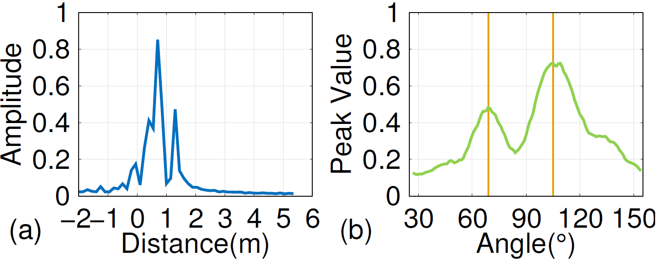
Evaluation – Software Defined Radar
TX and RX module on the same phased-array front-end.
FMCW signal processing after sampling.
Two objects at different range and angle.
Notes:
To verify the software defined radar design, we set up two example scenes.
First, we use a radar with an FMCW waveform to determine the distance of the objects by finding the peaks in frequency domain.
Two objects are placed at 90◦ relative to the antenna plane with 0.5m distance difference, which results in the two spectrum peaks shown in Fig. (a).
The two peaks are separated by around 0.5 m, which shows the feasibility of range detection.
Second, two objects are placed at 70◦ and 110◦ angles relative to the antenna plane at the same distance from the phased array. To estimate the relative angles of the objects,
the Rx phased array scans 128 beams evenly partitioning the polar angle on X-Z plane, while the Tx illuminates the scene using a quasi-omni beam and an FMCW waveform. By taking the peak
value of the frequency spectrum of each angle and apply a moving average with a 20 points window, we obtain the reflection response of different angle. The peaks are at 69◦ and 105◦, approximately the
direction of the two targets. This beam scanning approach represents a very rudimentary method of angle estimation.

Slide 44
Radar
4 Configurations:
TX
RX
Increase total aperture size allows for improved discrimination, at the cost of sidelobes depending on array spacing
Notes:
We vary the number of Rx phased arrays and generate corresponding AoA pseudo-spectrum using the MUSIC algorithm
As shown in Fig. 22, the two objects’ angles cannot be separated at all (i.e., a single AoA peak) with only one phased array and hardly with 2 arrays. With 3 phased arrays uniformly placed adjacently
(i.e., half wavelength separation between elements on the edge), the angular resolution is sufficiently high to clearly differentiate the two targets.
we investigate a non-uniform array layout Since this layout expands the effective antenna aperture size, the angular resolution is improved accordingly, but at the cost of prominent side lobes, which can be precluded based on prior knowledge.
improve the angular resolution of the Radar practically by coherently combining multiple phased arrays, and through non-uniform array layout

